Slide 1
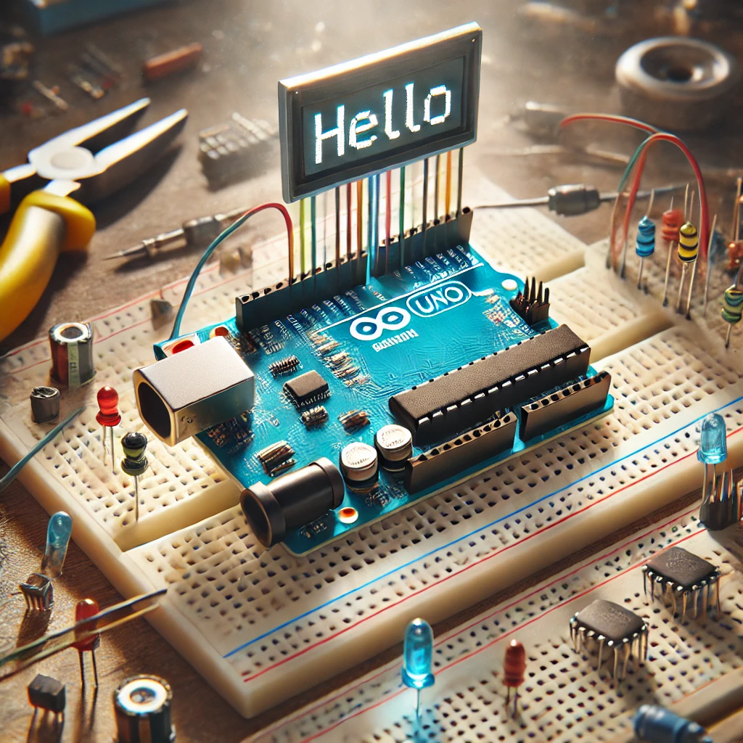
Introduction Arduino
Interactions and
SPI Protocol
By Reut Michaeli & Yaniv Gabay

Slide 2

Important
In this presentation, we will introduce many concepts that might be new to some of you.
Given our time constraints,
we won't be able to explore
each subject in depth.
תמונה של נפנוף ידיים

Slide 3
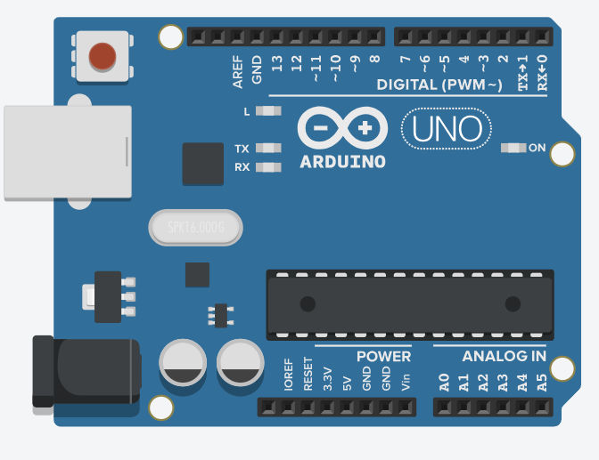
Understanding Arduino
A popular microcontroller board that easy to use for electronics projects.
Its simple.
Most of it open source .
And very flexible.
Microcontroller – Integrated circuit, that included a processor, memory, input and output peripherals, on a single chip.

Slide 4
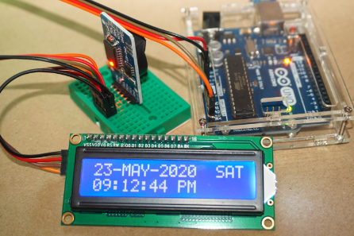
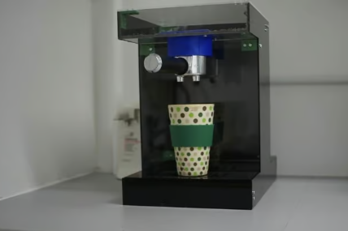
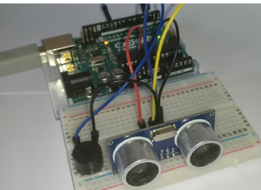
Some use cases of Arduino
Open source, easy to use, and popular = Many Modular Shields(basically add-ons), which can be plugged directly into the board.
LED screen Module
Parking Sensor
Espresso machine

Slide 5
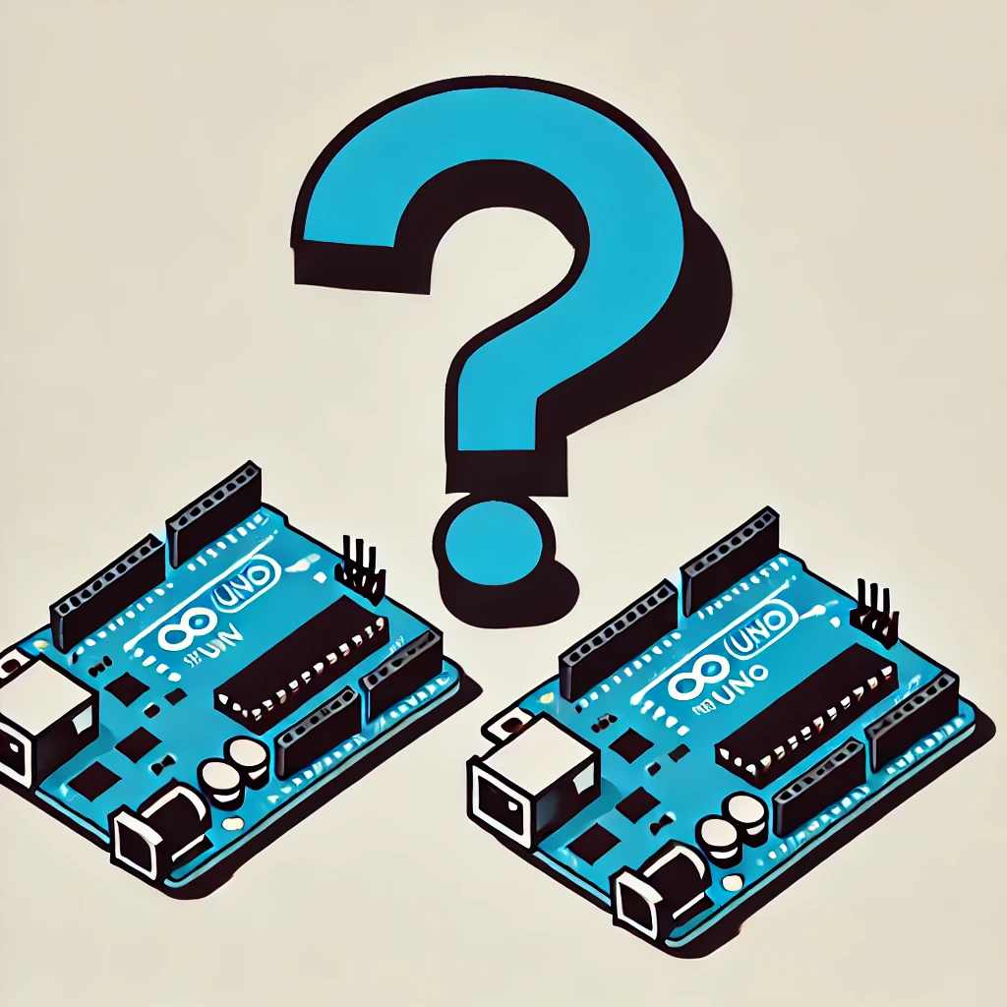
Communication is key
Multiple Devices – allows multiple devices to work together to accomplish a task
Data Sharing – to coordinate and make decisions better
Scale – not overload a single board with many tasks
And much much more….

Slide 6
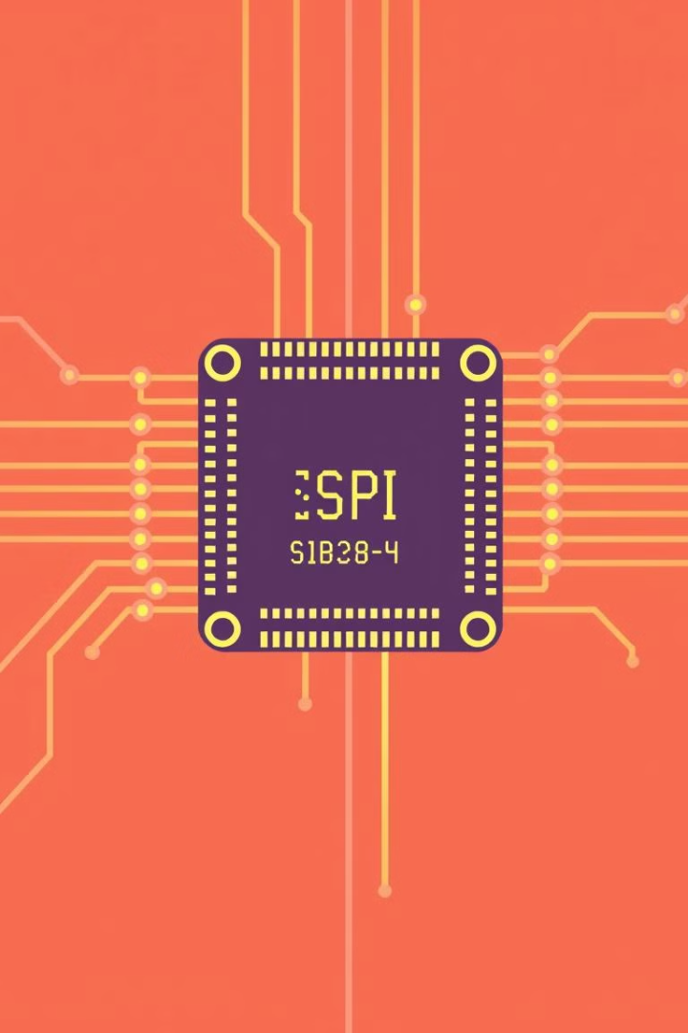
Understanding SPI Protocol
Serial Peripheral Interface, a communication protocol used for data exchange between a master device and one or more slave devices.
Master- The device that initiates and controls the communication. Generates a clock signal and select which slave to communicate with.
Slave- The device that responds to the masters' commands, operated only when selected.

Slide 7
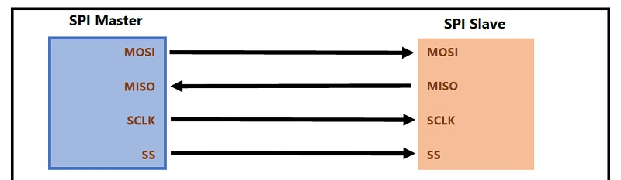
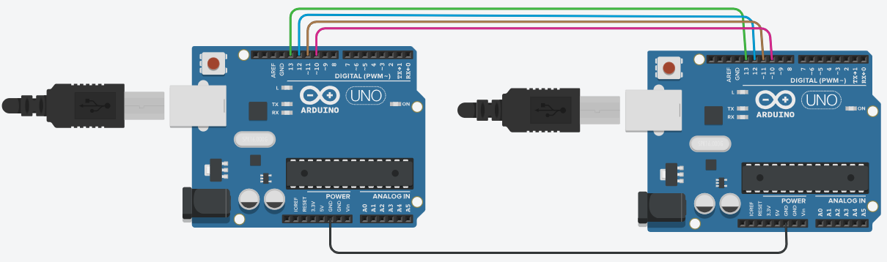
MOSI
MOSI
MISO
MISO
SCLK
SCLK
CS
CS
Master Out Slave In (MOSI) – The line over which data flows from master to slave
Master In Slave Out (MISO) – Data flow from slave back to the master
Serial Clock (SCLK) – Controlled by the master, this clock signal coordinates the timing of data transmission
Chip Select (CS) – A separate line from the master to each slave, used to active one slave at a time
All communication in SPI is based on the transition between LOW and HIGH digital signals. (like 0 and 1).

Slide 8


At last, we can talk about the first Exercise.
Goal:
Design and develop a simulation of the SPI communication between 2 Arduinos.
But we don’t have
Any equipment!
I Know! We can
use Tinkercad

Slide 9
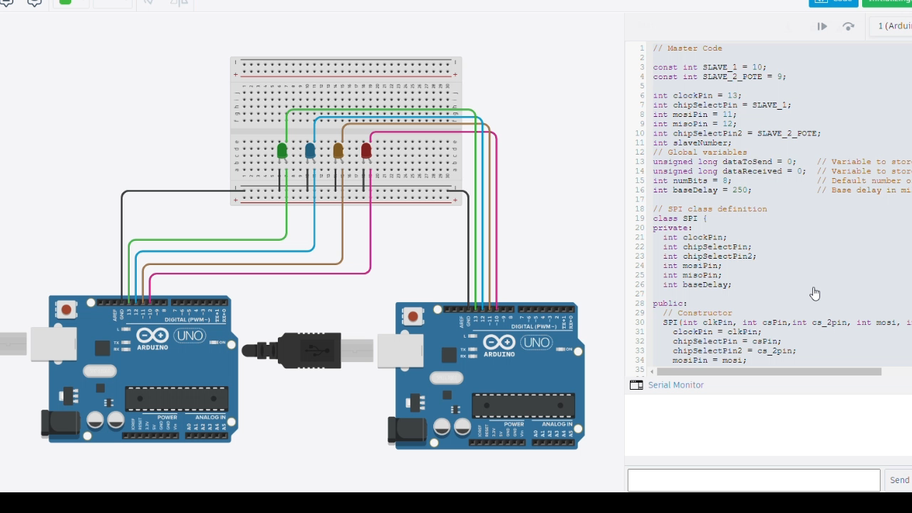
Tinkercad – A tool for designing and testing electronics projects virtually.
C++ code
Two Arduinos connected
With Bulbs to visualize the communication between
The master and slave
In the SPI protocol

Slide 10
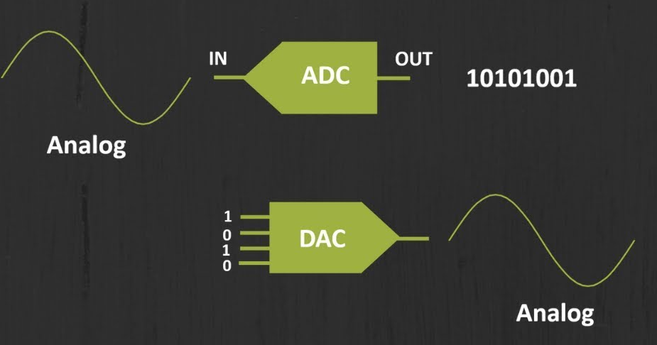
The Second Exercise
We created an SPI, we transformed into a modular class in C++.
We needed to create new classes:
Analog to Digital Converter (ADC) - Convert an analog signal,(like sound or temperature) into a digital signal which allows us to process it.
Digital To Analog Converter (DAC) - Convert a digital signal (binary numbers) back into an analog signal.
Each of those classes, has an SPI
Object that help them
Communicate with the Master

Slide 11
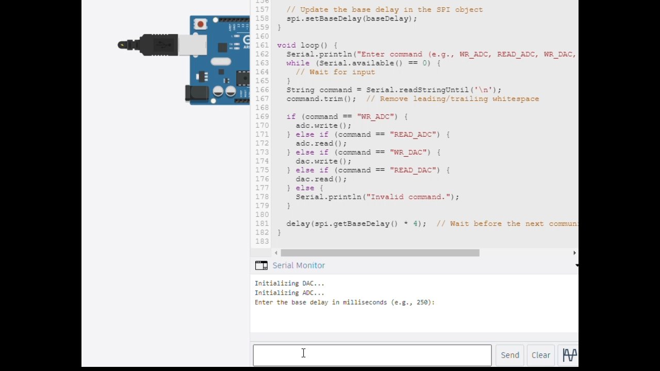
The Second Exercise
The user
Interact with the master
And chooses
Which operation
(Read, Write)
On Which component
(DAC OR ADC)
For example,
WR_ADC = Write to ADC

Slide 12
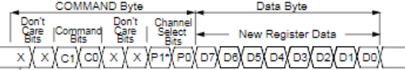
The Second Exercise
Last step was to create a Potentiometer class that communicates over the SPI , based on the Data sheet, we have received.
This represents the writing instructions or Data to the digital potentiometer.
In total 16 bits (and only 16 bytes).
First 8 bits represents the COMMAND byte, the last 8 bits are the Data byte.

Slide 13
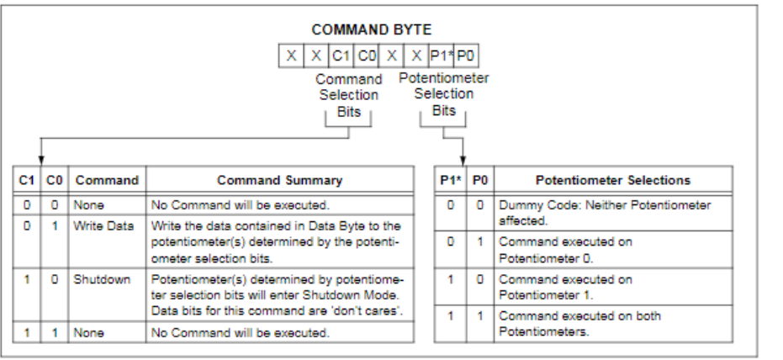
The Second Exercise
COMMAND Byte:

Slide 14
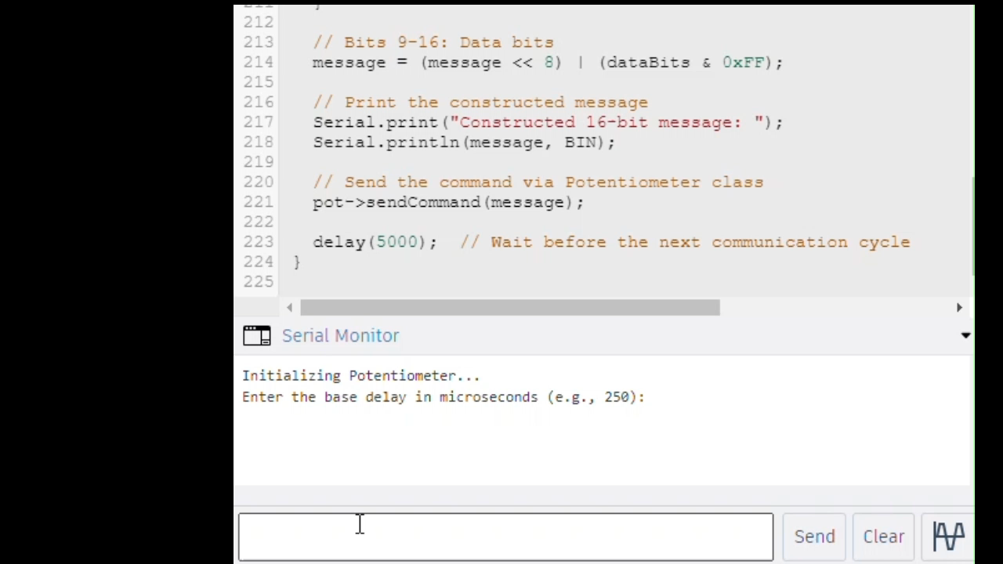

Slide 15

Thanks Alot
Thank you for your interest in the Aurdionu project.

